Slide 1

Best Buy Developer API
Mohammad Shafi Nikzada
Nils Jesper Cornetto
Kenneth Koomson

Slide 2

Reason for selecting
Very good documentation
Query Builder tool http://bestbuyapis.github.io/bby-query-builder/
The documentation includes:
details on how to make API calls, the structure of the response data, and sample code for different programming languages.
Registration for an API key is needed
Easy access to the key through simple signup with email address(no free or .edu)
https://developer.bestbuy.com/

Slide 3
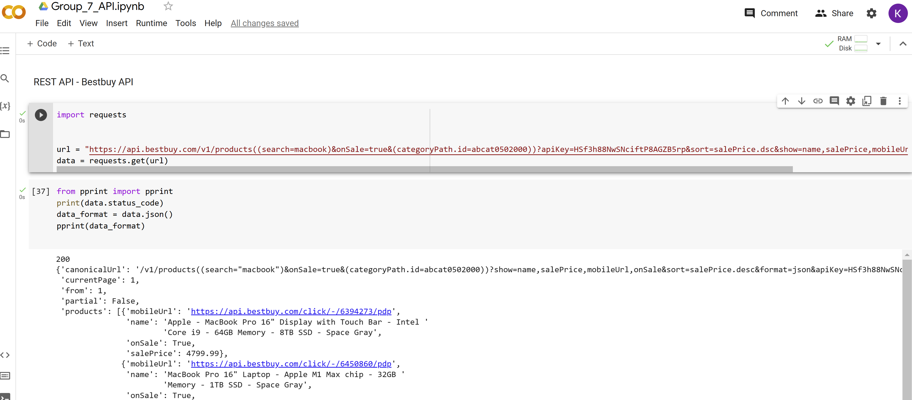
Data Download

Slide 4
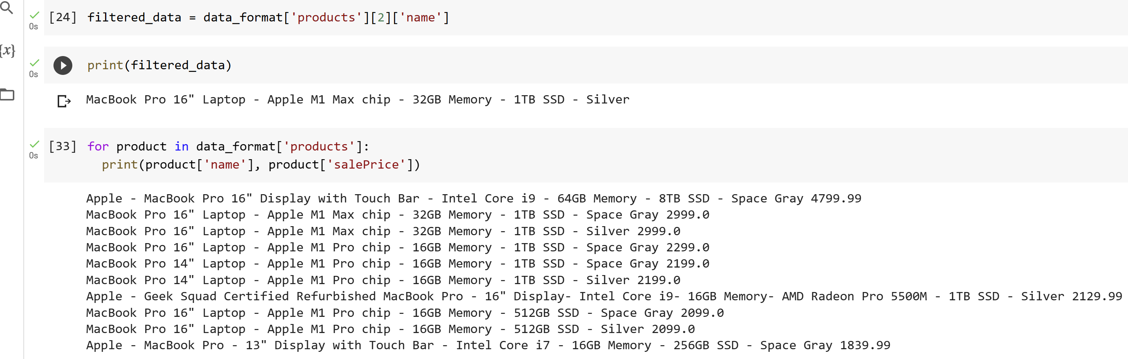
Basic filtering and query

Slide 5
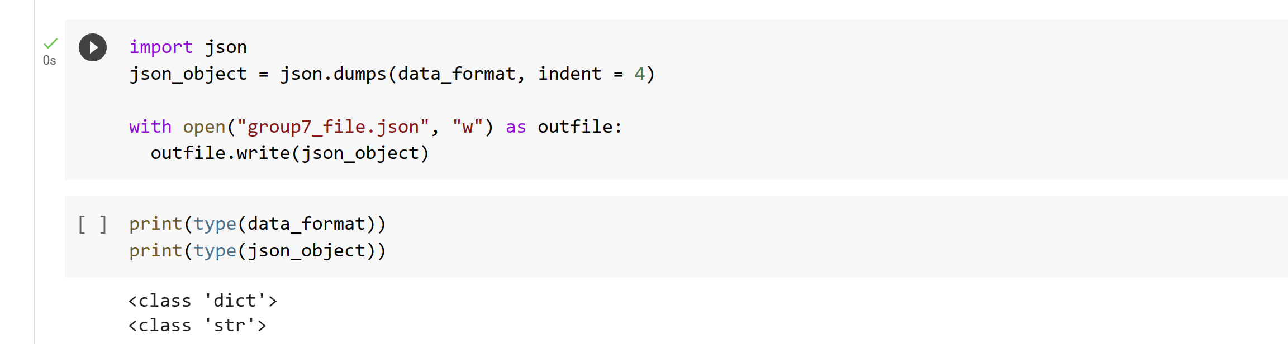
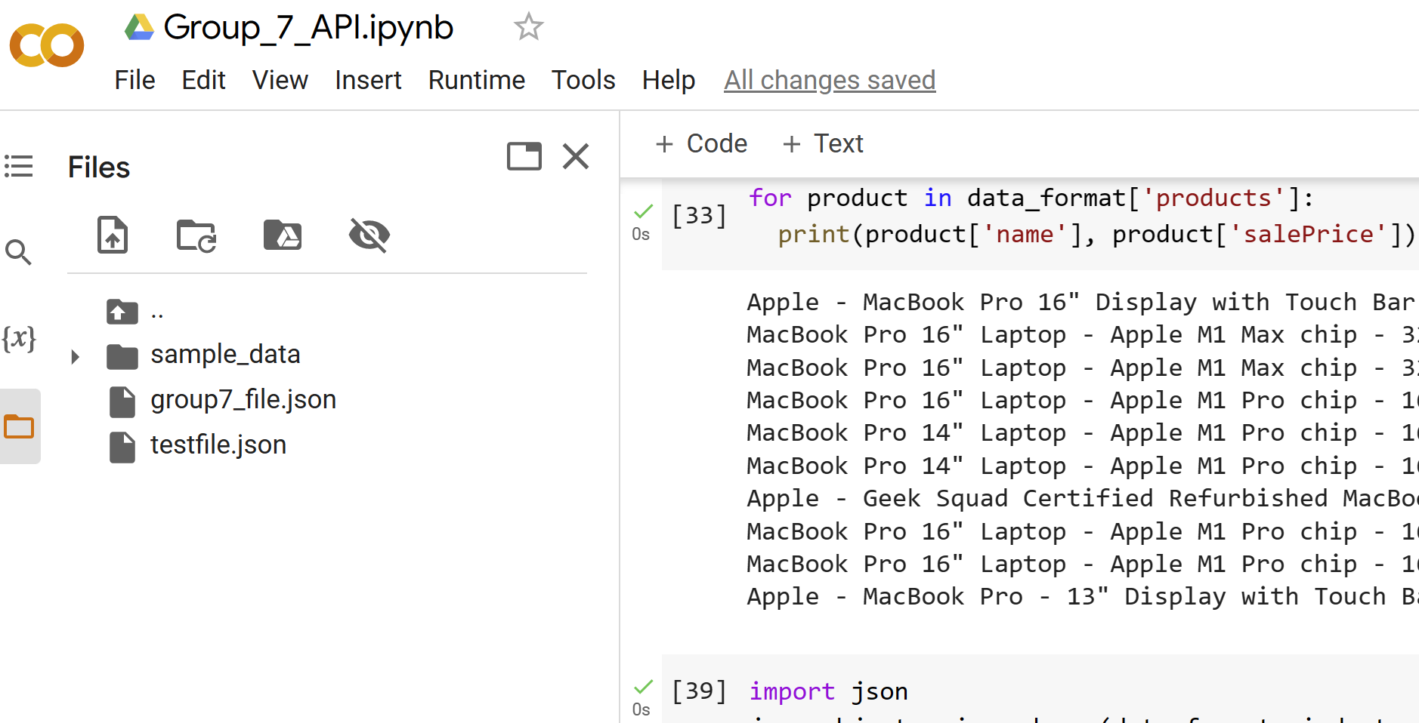
Data saving to file

Slide 6
Link to .ipynb files
Rest Api
https://colab.research.google.com/drive/1dbyPVvM8Pep_jfHZR6H8ya8apzLZehlo?usp=sharing
Streaming
https://colab.research.google.com/drive/1tGhs9cLgWdx7Az_lNYDBI1IlmPZZ8SoF?usp=sharing

Slide 7

Thank you!

